Slide 1
GIT

Slide 2

Agenda
GIT
Compared with SVN
GIT Flow
Review
Hands-on workshop

Slide 3

GIT vs. SVN

Slide 4
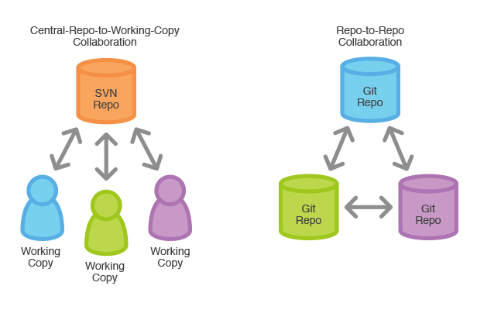
GIT vs. SVN / Distribution / Repositories
GIT is distributed, SVN is not ➔ more flexibility
Notes:
each developer has the entire history
faster than SVN because most operations as local (e.g. log)
side benefit: the repository is backed-up on many more locations (on developer’s computer)
HDD space not a problem
GIT is very efficient
HDDs are cheap
GIT also allows us to have a central repository, it just doesn’t force it
for our projects we will use a central repo for CI
but GIT allows developers to communicate between themselves if needed (e.g. work together on one feature)

Slide 5
GIT vs. SVN / Distribution / History
GIT has real branches, SVN has linear history with simulated branches (just directories)

